Slide 1

The Rastaban project
For researching and monitoring at micro level

Slide 2
Presentation layout
Introduction Rastaban
Background Rastaban
My contribution to Rastaban
Plans for the future
Summary

Slide 3
Introduction Rastaban
Preperation for measurement
Heating/cooling liquid
Reaction
Combining reaction liquid with the liquid to be examined
Observation
Observing reaction for a certain time
Record
Observed images are stored on storage medium (local or online)
Goal
Process
Plans for the future
Closing

Slide 4
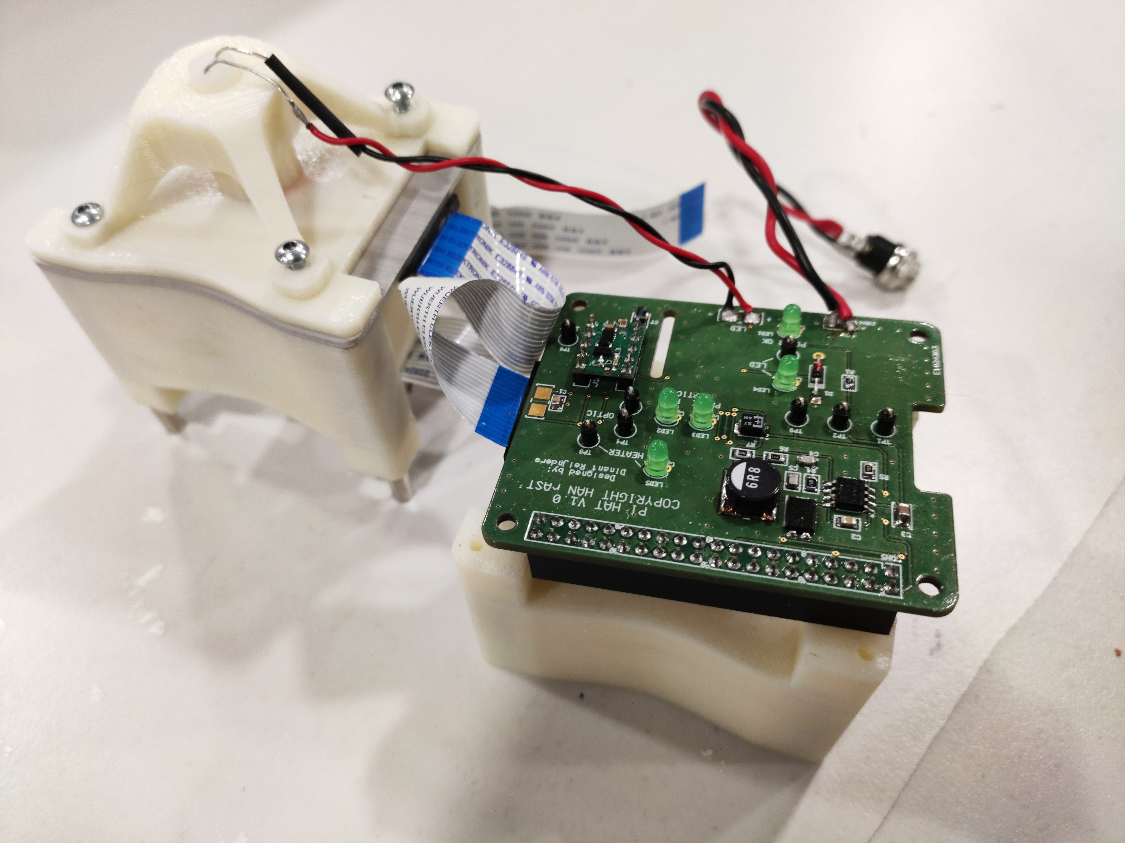
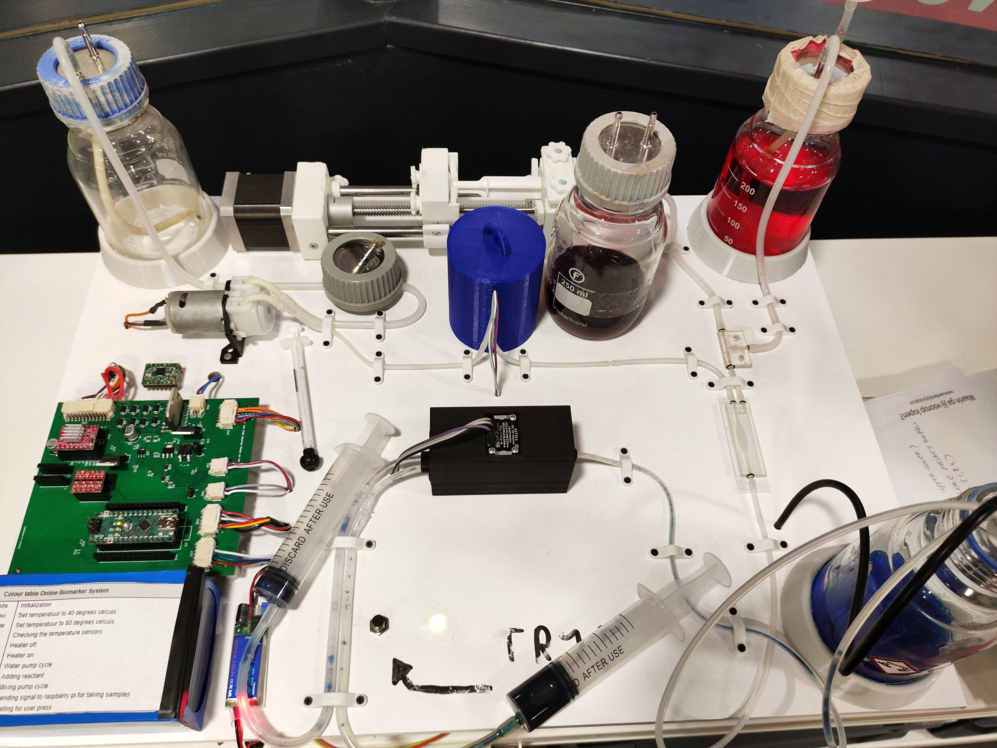
Background Rastaban
Company
HCL
Members
Subjects
Activities
Previous Rastaban groups
S4
Focus: Camera
S6
Focus: Spectrometer

Slide 5
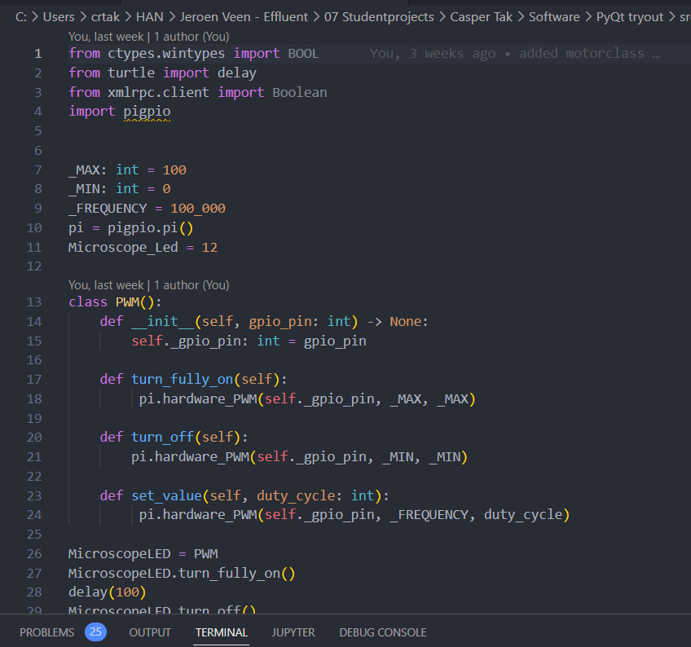
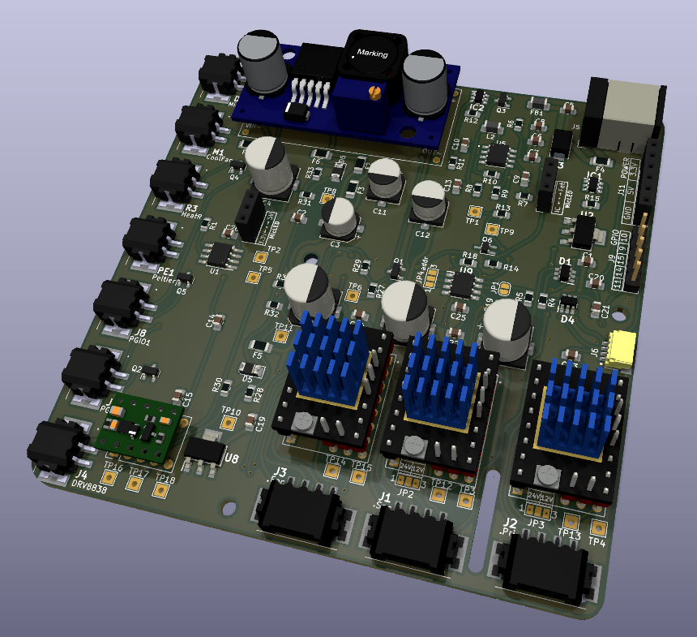
My contribution Rastaban
In general
Fully functional prototype
Size reduction
Increase robustness
PCB
Goal
KICAD6
Pluggins
Software
Goal
PyQt
GUI
Qt Functions

Slide 6


Future Plans
In general
Portable
Increased effiency
More robust
Water Quality Monitor
DNA

Slide 7

Summary
HCL
Goal Rastaban
My Contribution
Future goals

